Slide 1
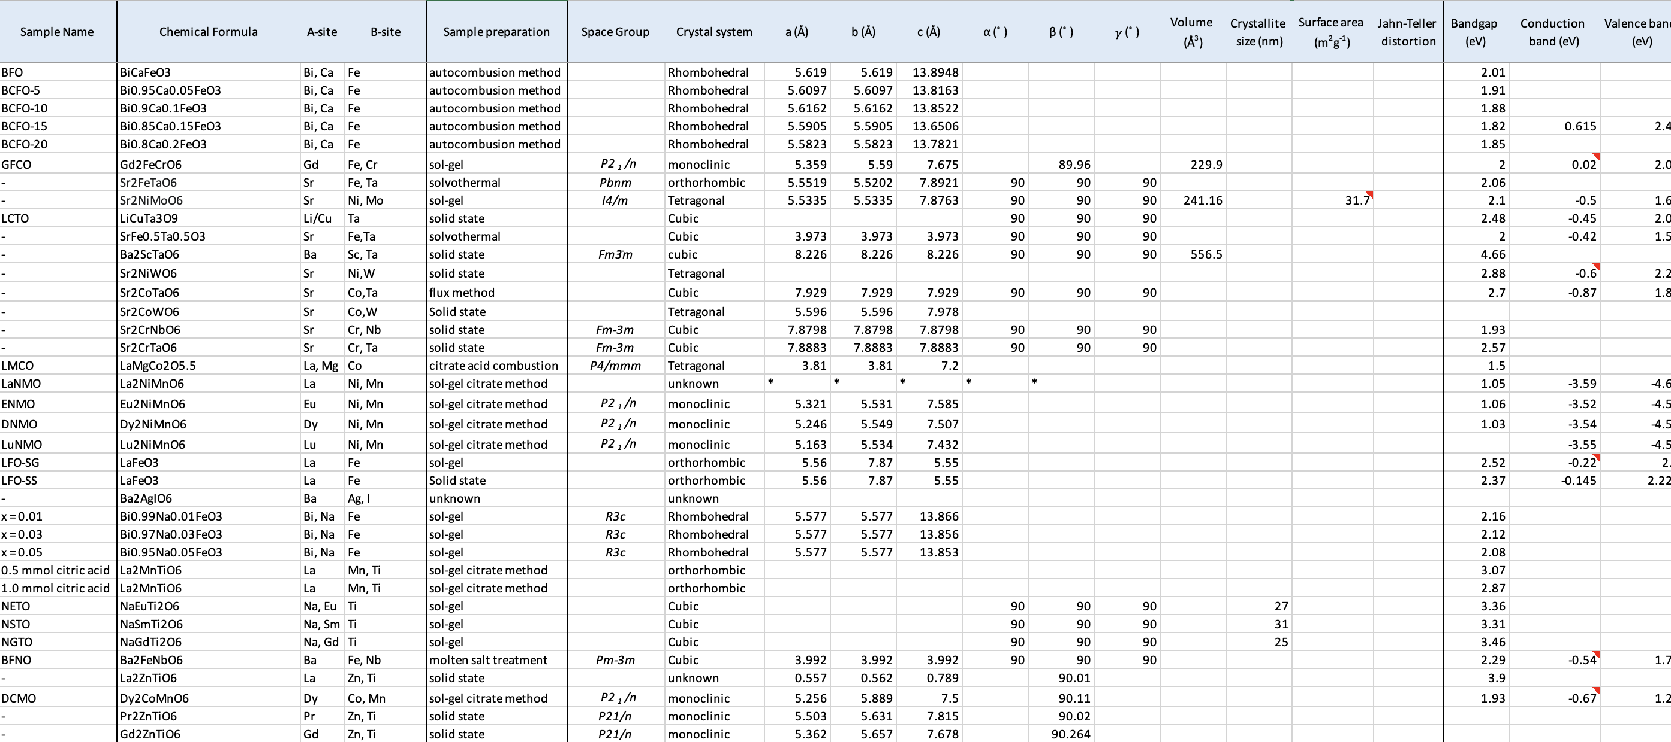



Density Functional Theory and Machine Learning applied for Perovskite Materials
Jiri Hostas
8th Annual Alberta Nano Research Symposium
April 1, 2023
Funded by AI4D NRC project: Dennis Salahub, John Garcia, Hatef Shahmohamadi, Maicon Lourenco,
Alain Tchagang, Venkataraman Thangadurai, and Karthik Shankar
github.com/jiri-hostas

Slide 2
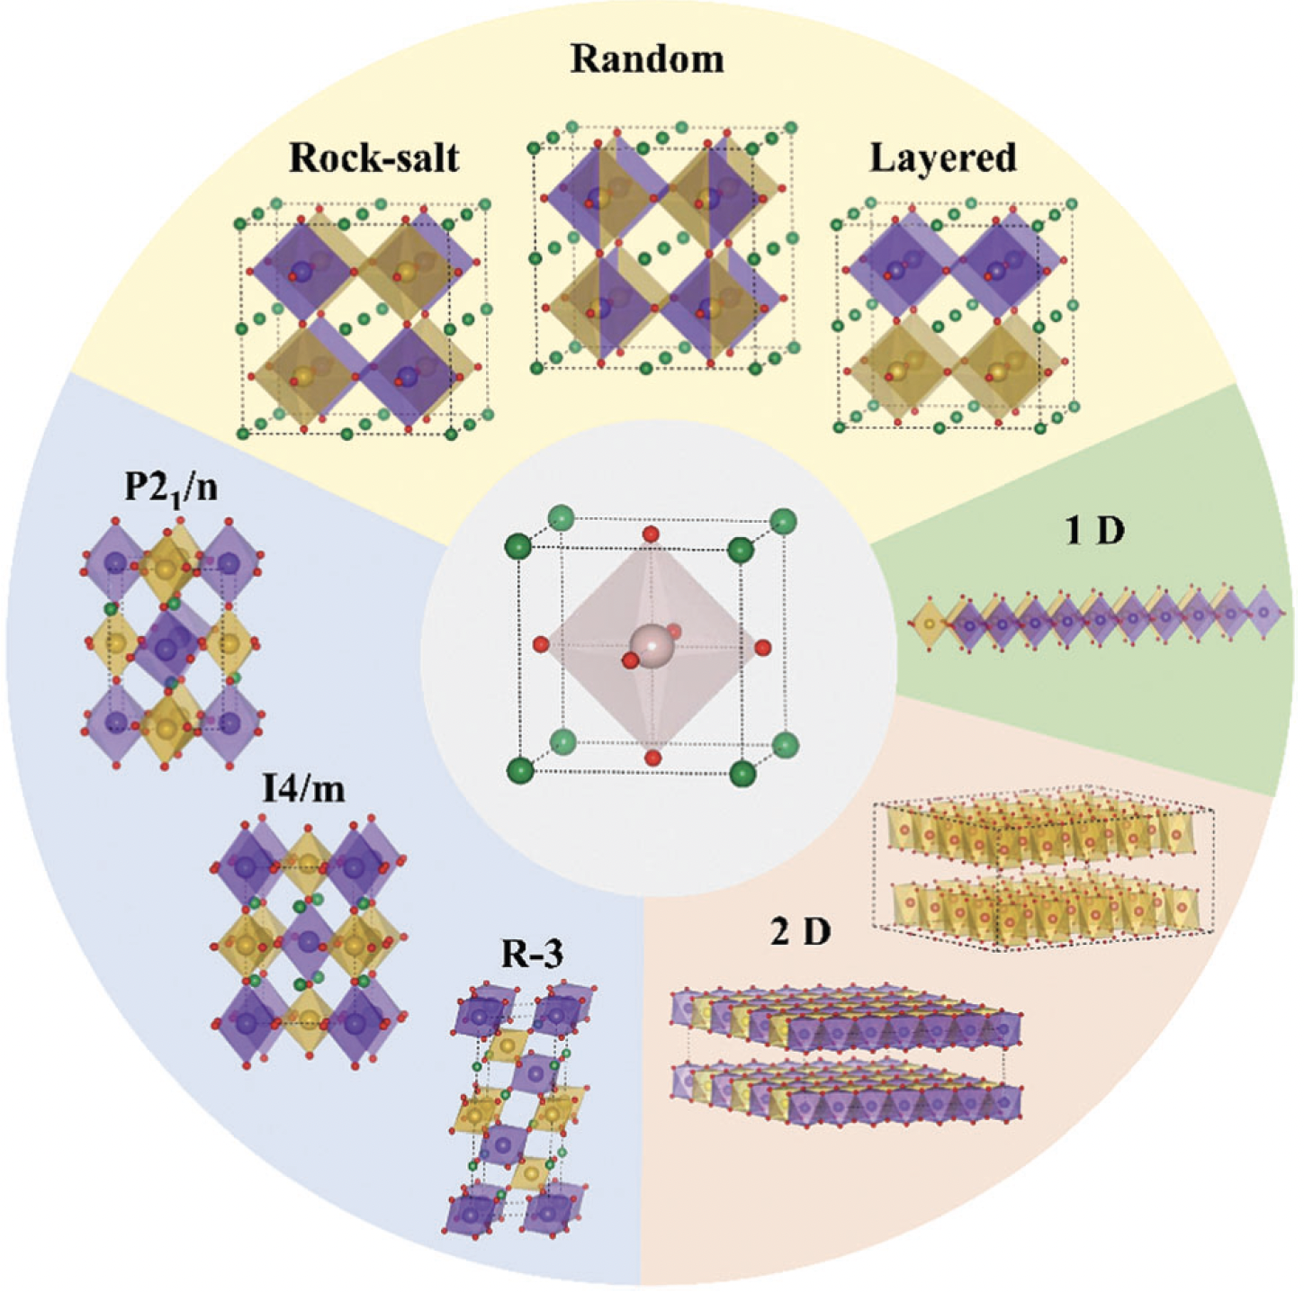
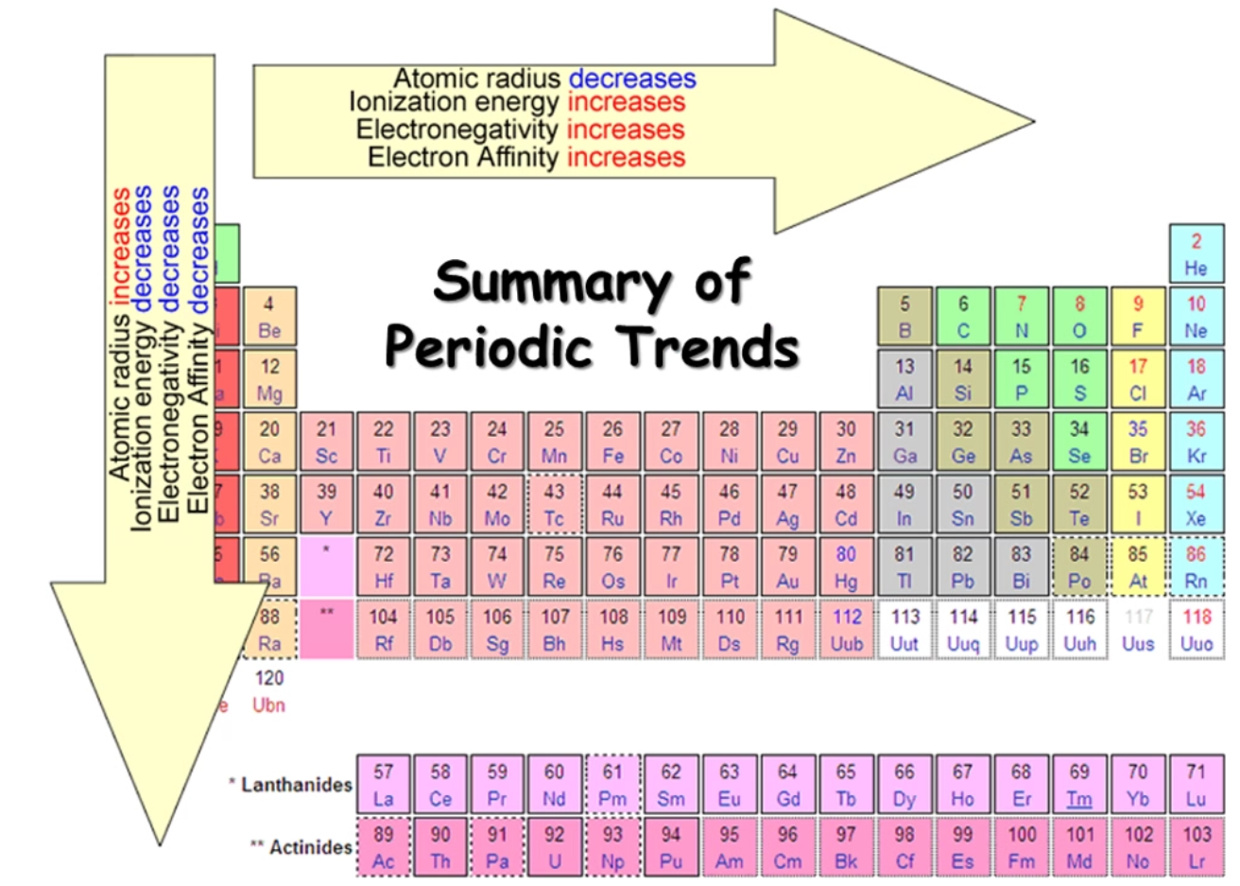
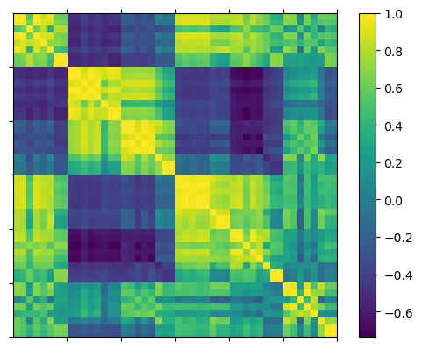
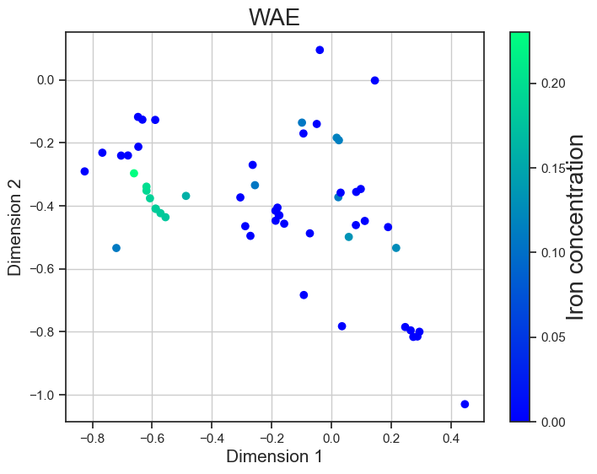
Outline
Introduction
Perovskite chemistry
Where can ML help?
Results
1. Role of Vacancies and AL
2. Experimental dataset
Descriptors
Regression models
Visualization
Conclusions
A1 A2 B1 B2 A1/B1 A1*B1
Fe
Graphic for periodic table trends taken from DOI: 10.1039/C7NH00010C

Slide 3
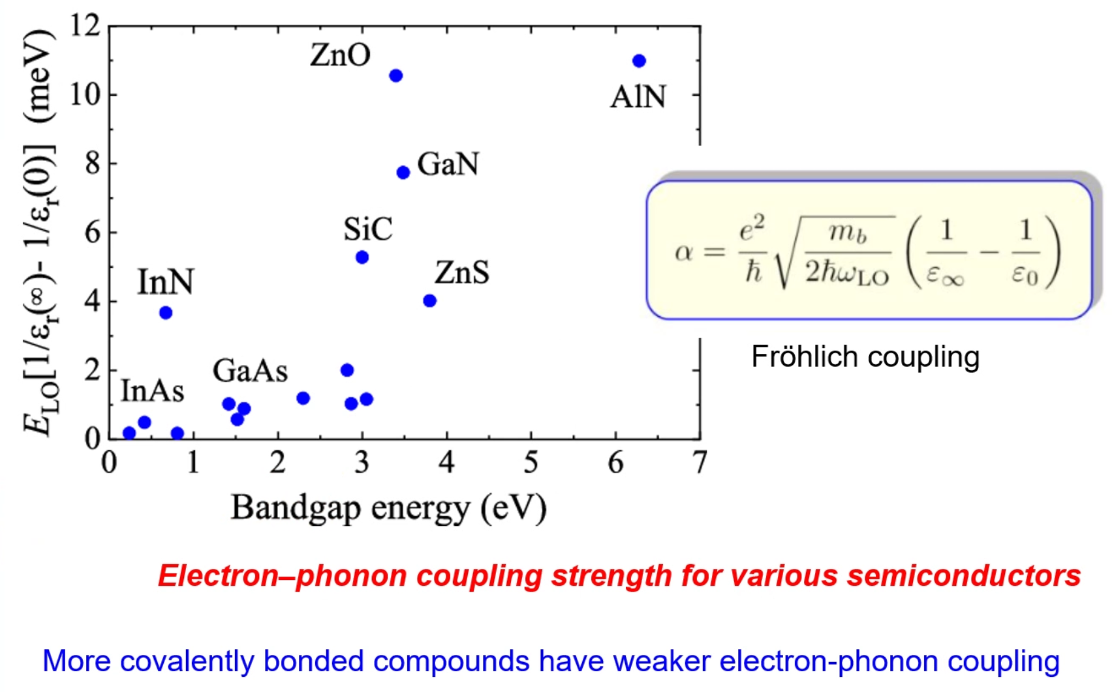
Oxide Perovskites
CaTiO₃, ABO₃, or AA’BB’O₆
Functional materials
Versatile catalysts:
Water splitting reaction
CO₂ reduction
Semiconductors
Graphics for structural flexibility is from DOI 10.1039/c8ee01574k
Notes:
Originally CaTiO3 but many other cations can be substituted: A and B are large electropositive cations. The ideal cubic structure has the B cation in 6-fold coordination, surrounded by an octahedron of anions, and the A cation in 12-fold cuboctahedral coordination

Slide 4
Theoretical Studies
Coarse grain & Mesoscale
Molecules & Segments
Force Fields
Atoms
e.g. ReaxFF, UFF
Semi-empirical QM
Orbitals
DFTB
Ab initio
Electrons
DFT-D

Slide 5
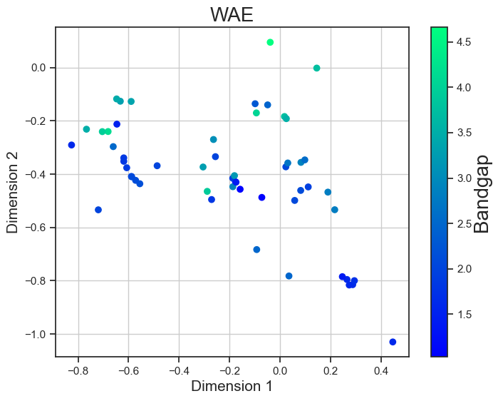
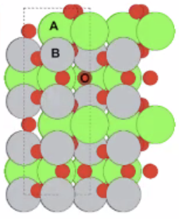
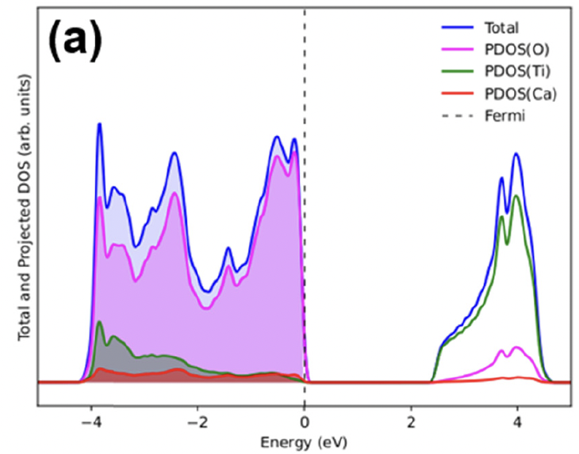
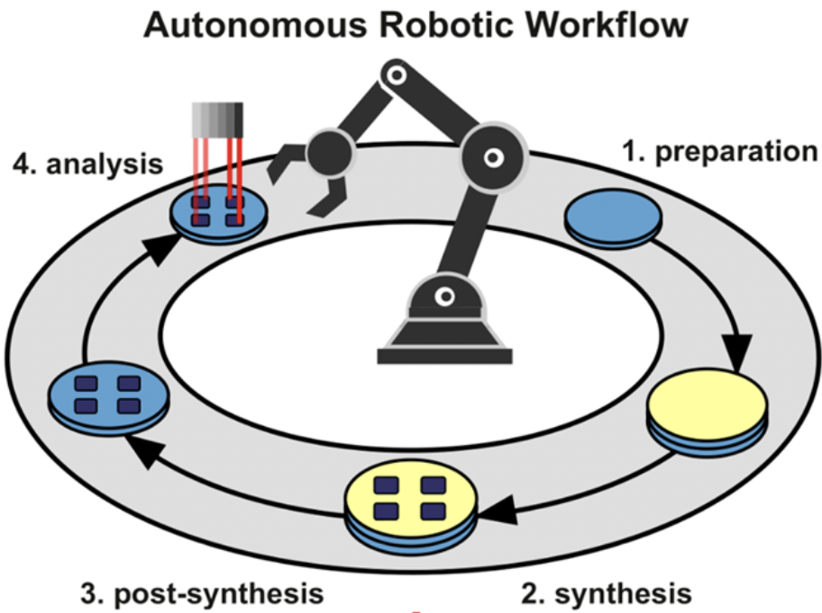
Accelerating Material Science Using AI/ML
1. Material
structure and characterization
2. Predict properties or
propose new materials
3. robotics/optimization
of reaction conditions
Graphics for autonomous chemical experiments taken from 10.1021/acs.accounts.2c00220

Slide 6
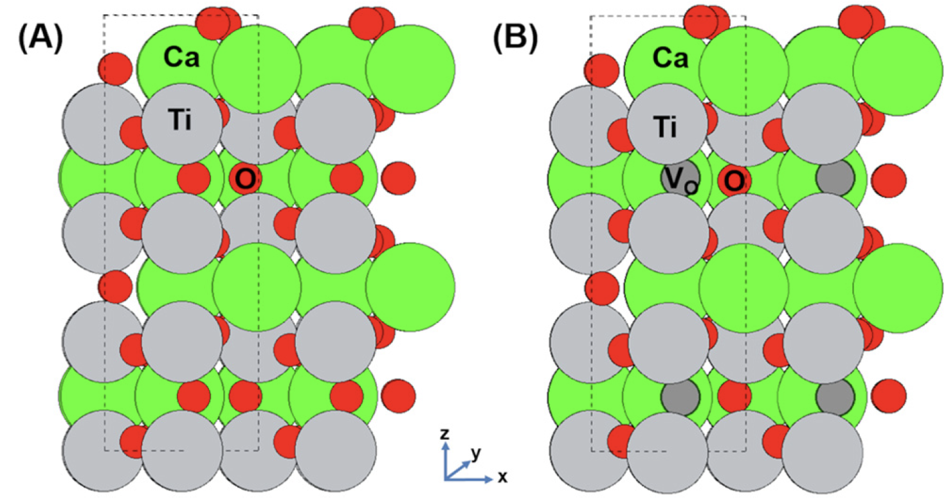
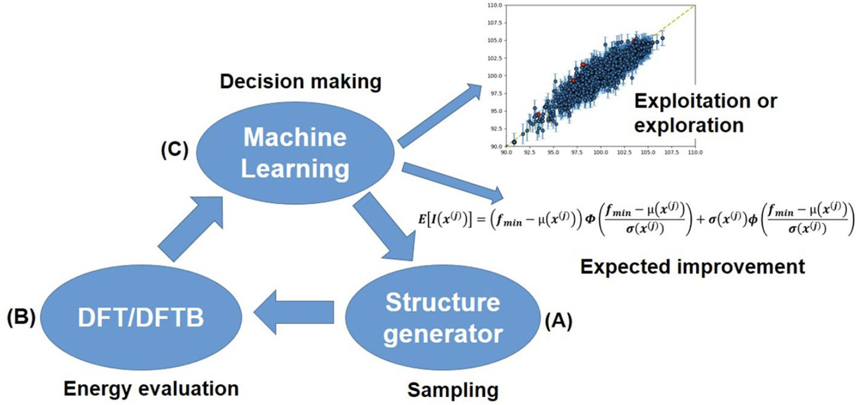
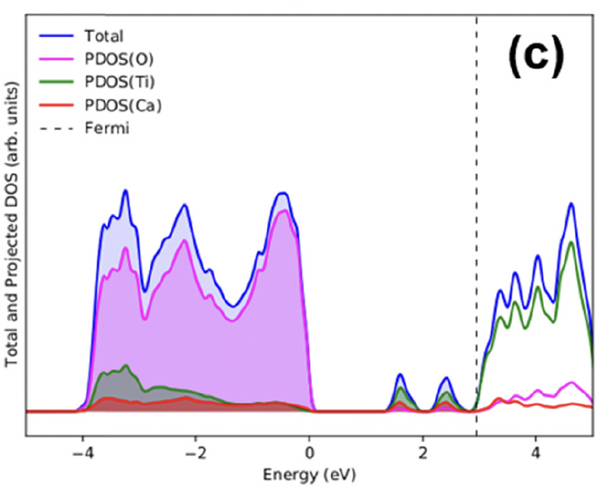
1. Role of Vacancies in CaTiO₃
Pristine CaTiO₃
(A)
Active Learning
Modified CaTiO_{2.625}
(B)
Maicon P. Lourenço, Lizandra Barrios Herrera, Jiří Hostaš et al. Phys. Chem. Chem. Phys. 2022, 24, 25227
Notes:
- low oxygen atmosphere ...

Slide 7
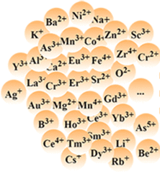
Number of Double-Perovskites
AA’BB’O₆
>> 10⁷ combinations
Narrow bandgap is important for e.g. semiconductors
Catalysts for specific reactions have a certain bandgap range

Slide 8
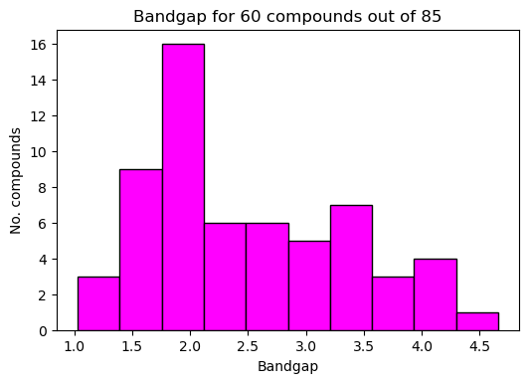
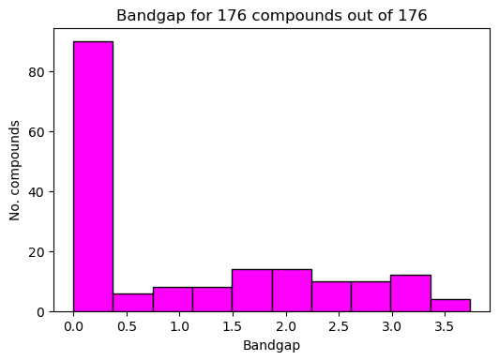
2. ML for Direct Prediction of Band Gap
The Materials Database
Experiment
Reflection of research focus and interests, method of measurement/calculation, dataset size, type of compounds etc.

Slide 9
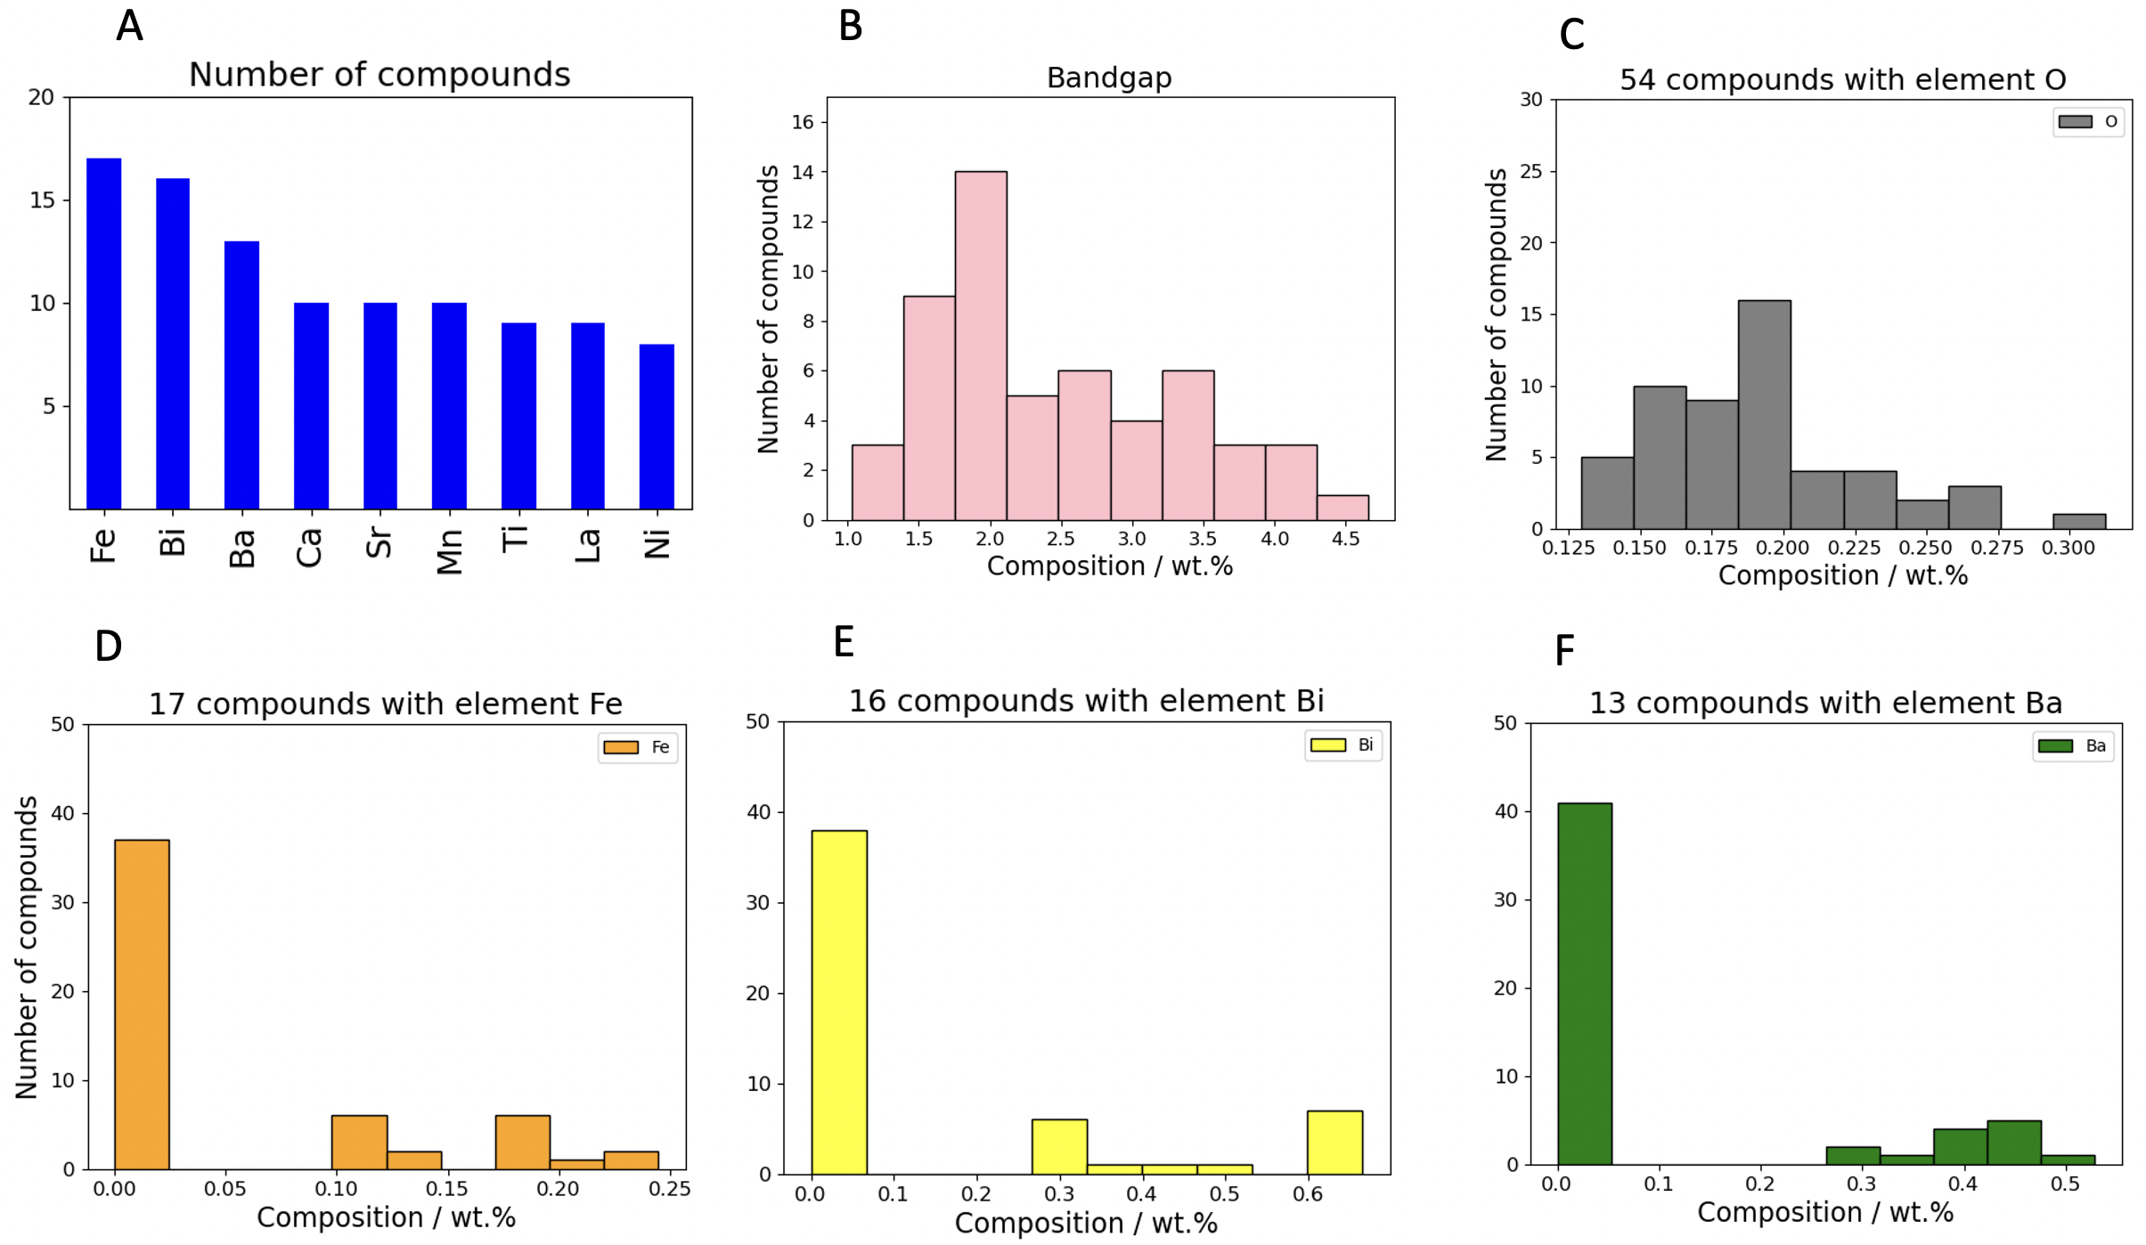

Slide 10
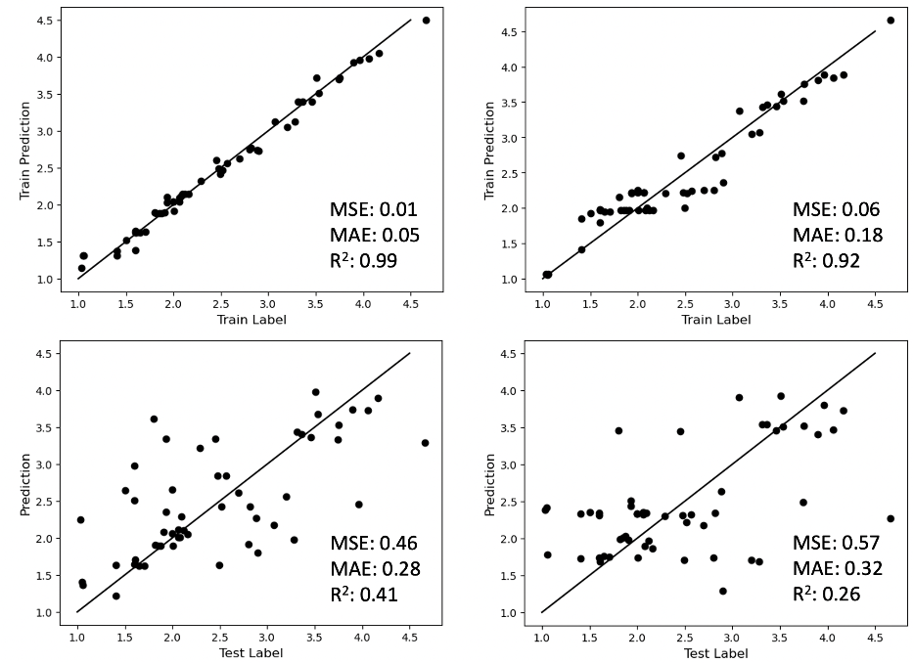
1st step: Composition only
Bi₁Ca₁Fe₂O₆ double-perovskite weight composition vector:
[0.46, 0.09, 0.24, 0.21, 0.00, … ]
[ Bi, Ca, Fe, O, Gd, … ]
training
Key takeaway:
slight improvement
when we optimize
the models but still a
weak descriptor
testing
39 features, weight compositions:
['Bi', 'Ca', 'Fe', 'O', 'Gd', 'Cr', 'Sr', 'Ta', 'Ni', 'Mo', 'Li', 'Cu', 'Ba', 'Sc', 'W', 'Co', 'Nb', 'La', 'Mg', 'Mn', 'Eu', 'Dy', 'Lu', 'Ag', 'I', 'Na', 'Ti', 'Sm', 'Zn', 'Pr', 'V', 'Ce', 'Nd', 'In', 'Te', 'Ga', 'Tb', 'Y', 'Al']
Notes:
Default hyperparameter model versus hyperparameter optimized model.

Slide 11
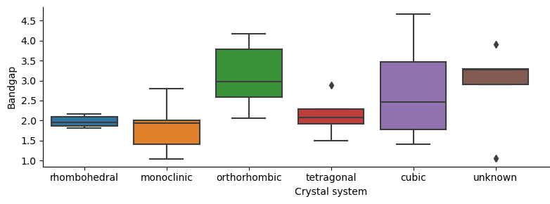
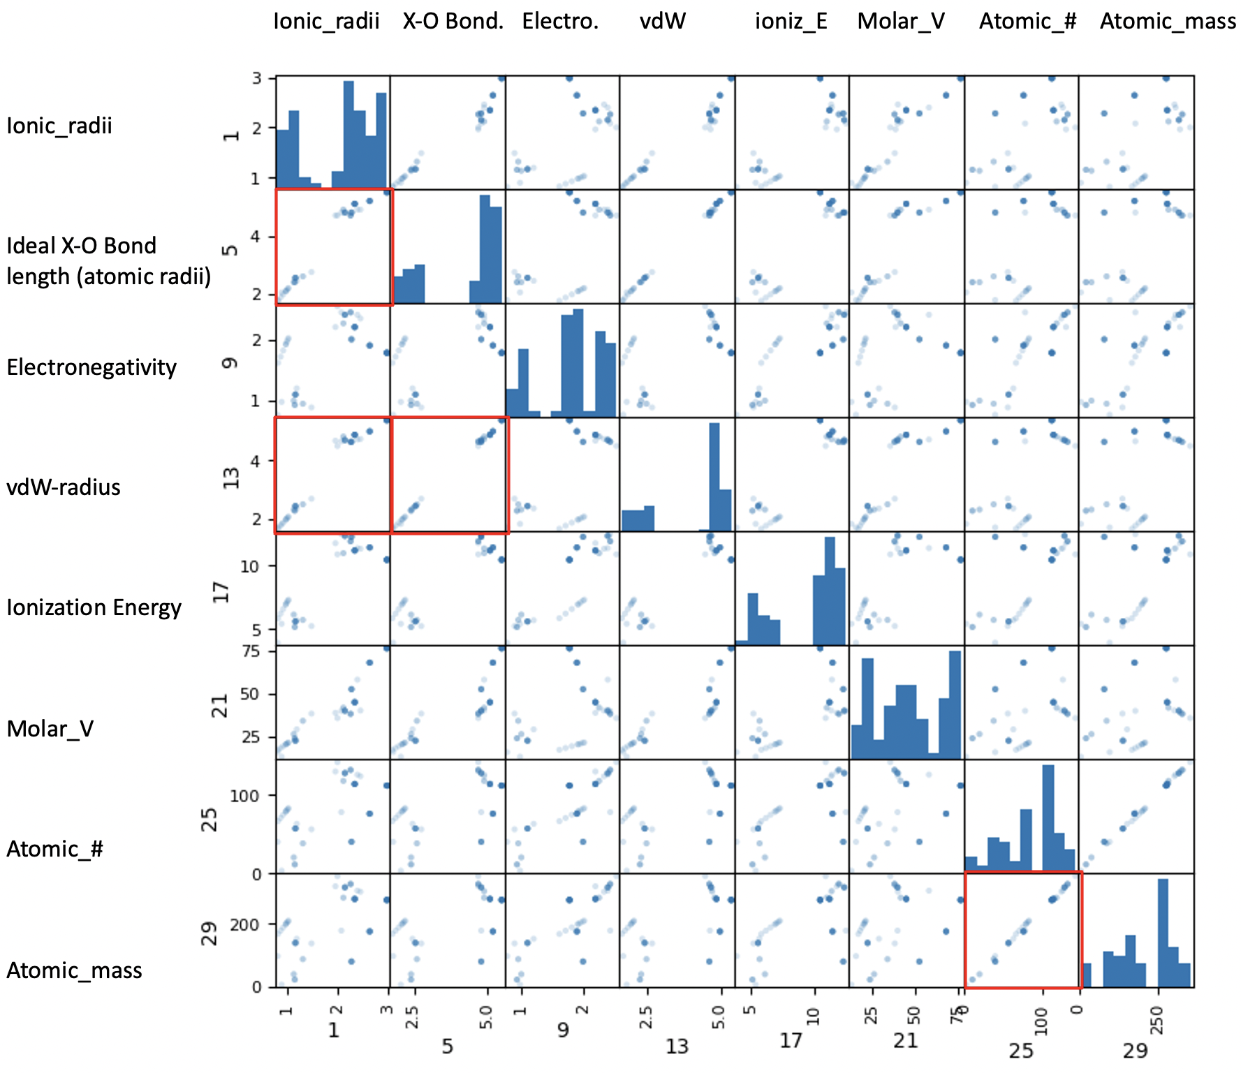
Descriptors included:
Compound mass composition
Sample preparation
Atomic features (tabulated)
Shannon’s ionic radii
Ideal bond length
Electronegativity
Van der walls radius
Ionization energy
Molar volume
Atomic number
Atomic mass
Geometric criteria
Tolerance factor
Octahedral factor
Target property:
Experimental Bandgap
Bi₁Ca₁Fe₁O₃ double-perovskite weight composition vector (before std):
[0.46, 0.09, 0.24, 0.21, 0.00, … ]
[ Bi, Ca, Fe, O, Gd, … ]
From literature
From periodic table
of elements

Slide 12
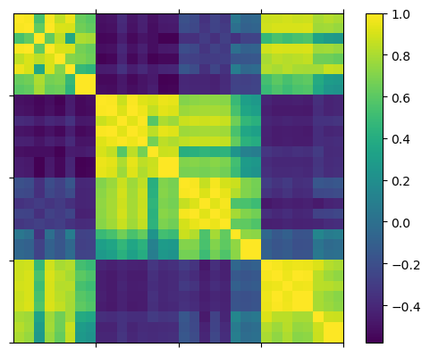
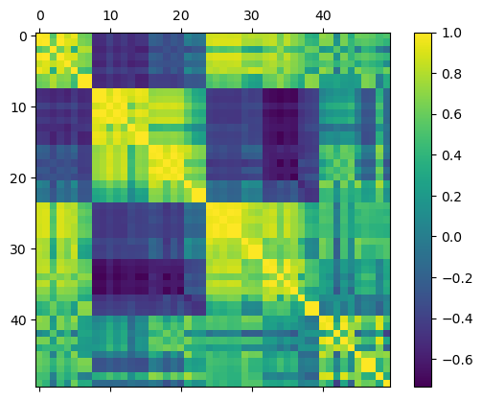
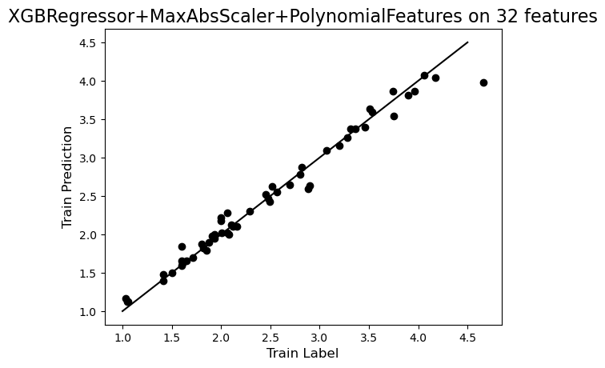

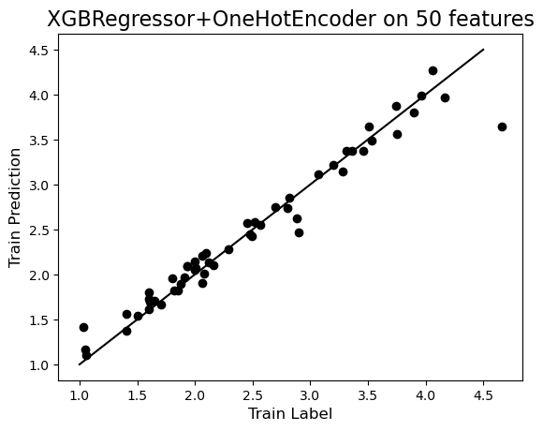
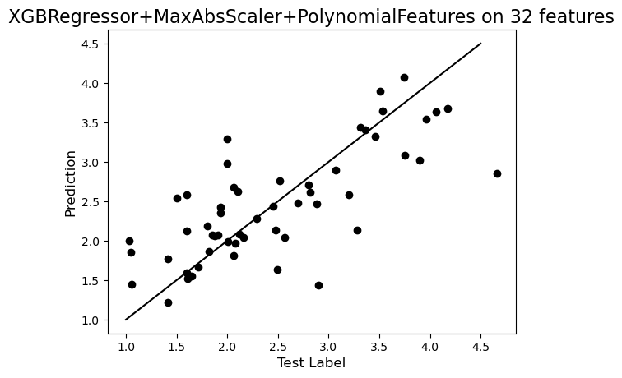
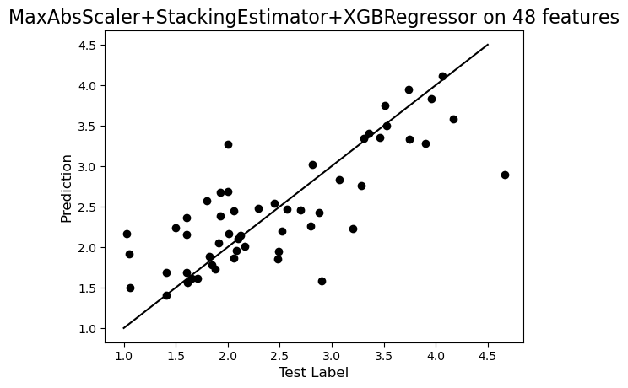
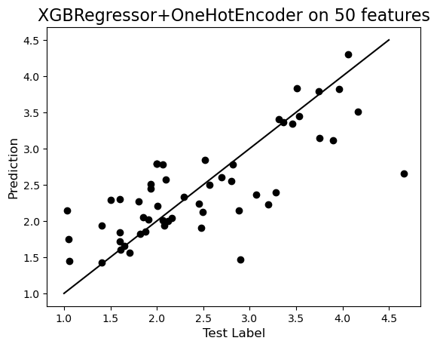
A1 A2 B1 B2
A1 A2 B1 B2 A1/B1 A1*B1
Added geometrical factors
A1 A2 B1 B2 A1/B1 A1*B1 factors
MSE: 0.02
MAE: 0.06
R²: 0.98
MSE: 0.02
MAE: 0.07
R²: 0.97
MSE: 0.04
MAE: 0.07
R²: 0.95
MSE: 0.35
MAE: 0.35
R²: 0.55
MSE: 0.30
MAE: 0.24
R²: 0.62
MSE: 0.32
MAE: 0.24
R²: 0.59

Slide 13
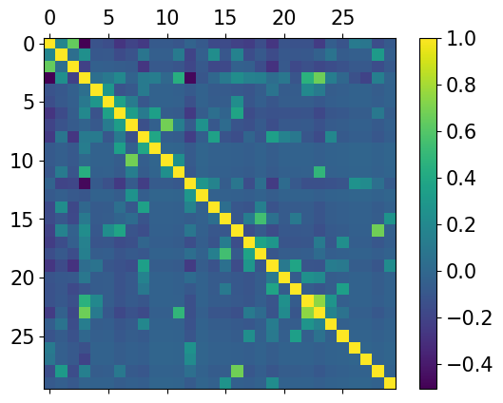
Weight compositions descriptor
A1 A2 B1 B2 A1/B1 A1*B1
training
MSE: 0.02
MAE: 0.07
R²: 0.97
overfitting
testing
MSE: 0.30
MAE: 0.24
R²: 0.62

Slide 14
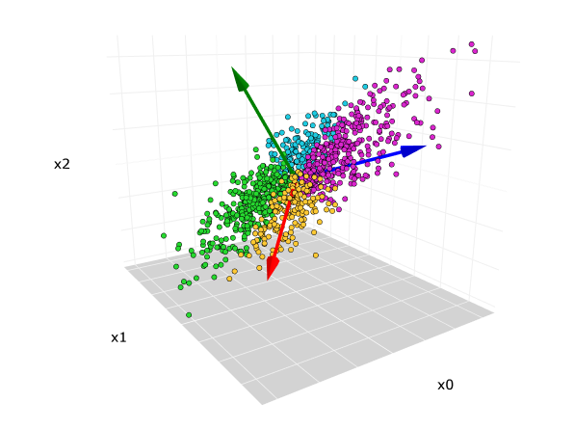
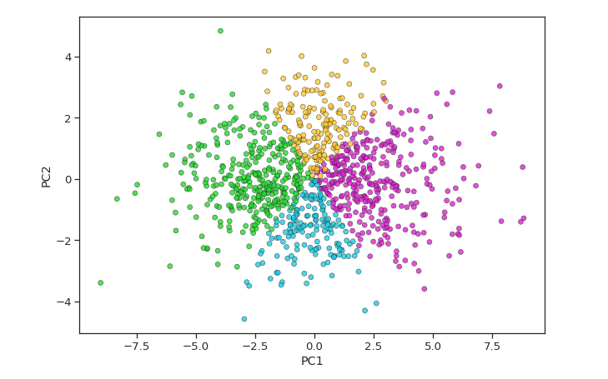
Feature engineering/reduction and visualization
Principal Component Analysis
PC3
PC1
PC2
3D data
2D data

Slide 15
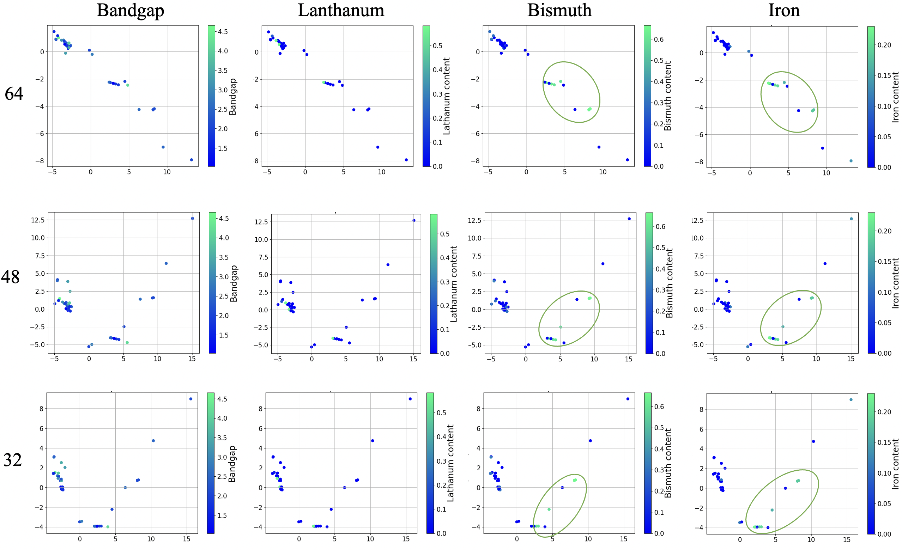
PCA
A1,A2,B1,B2
A1/B1,A1B1
A2/B2,A2B2
A1,A2,B1,B2
A1/B1,A1B1
A1,A2,B1,B2

Slide 16
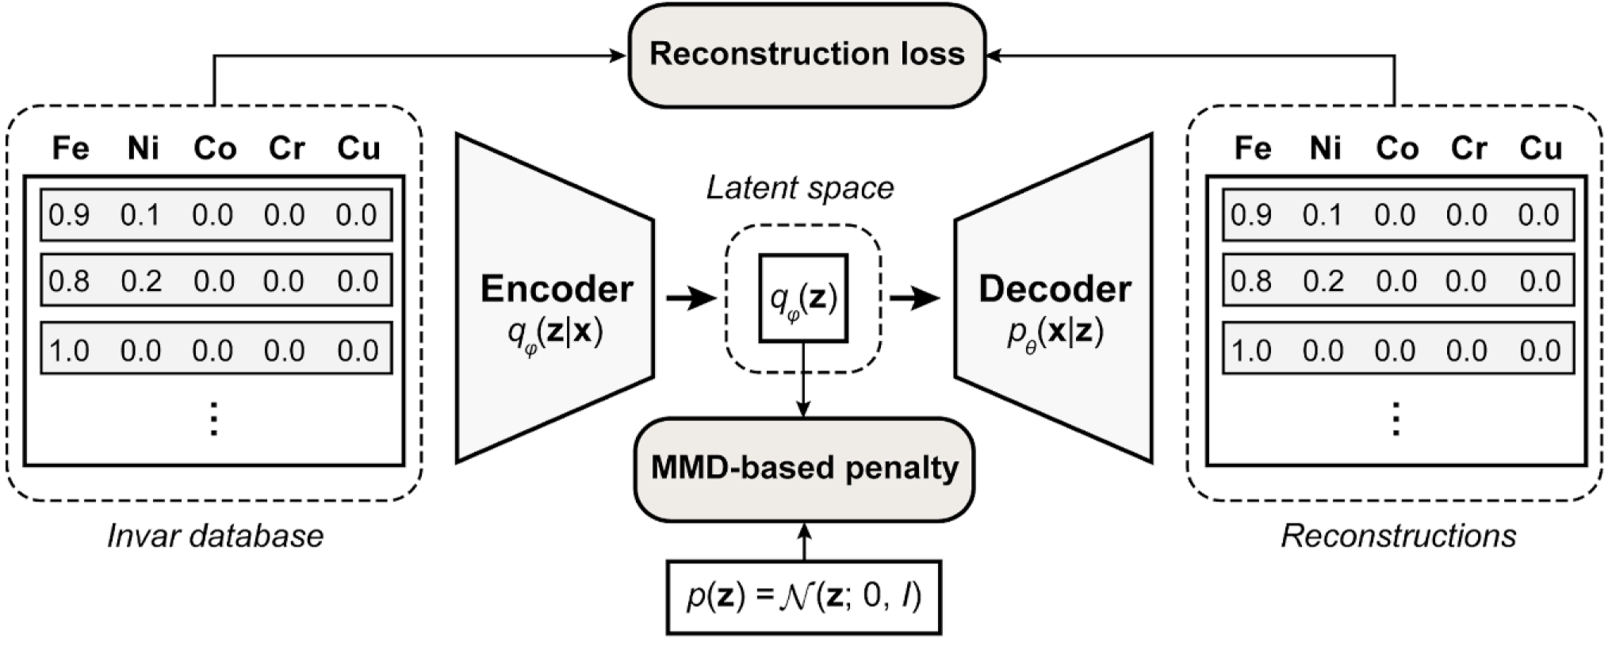
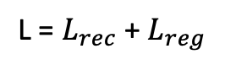
Latent Space via Wasserstein Autoencoders
*Ziyuan Rao et al. Science 2022, 378, 78
To reduce the high-dimensional search space
Data visualization
$$\text{L}\text{ = }L_{rec}\text{ + }L_{reg}$$
Figure S4A: Deep generative model. “Although WAE is trained
only on compositional data, it may include information
on composition-related properties… making the latent
space physically meaningful and informative.”*
Notes:
Constrained autoencoder architecture by Gaussian prior. Lrec is binary cross-entropy of input-output pair and Lreg is defined as maximum mean discrepancy (MMD) between the latent space distribution and a Gaussian prior. MMD is a kernel-based statistical measure used to determine whether given two distributions are the same. Two distributions are similar if their moments are similar.

Slide 17
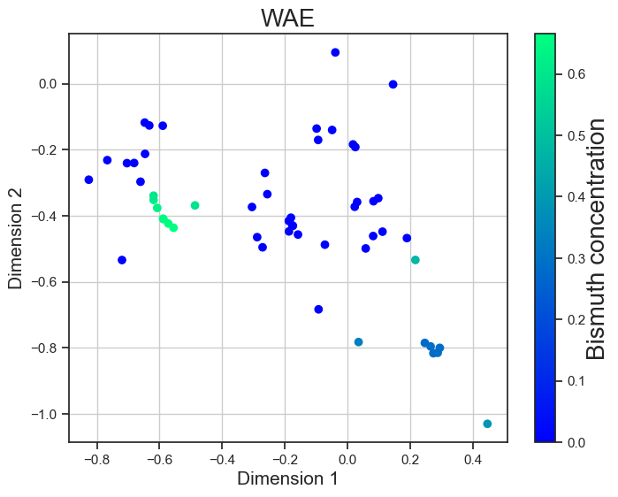
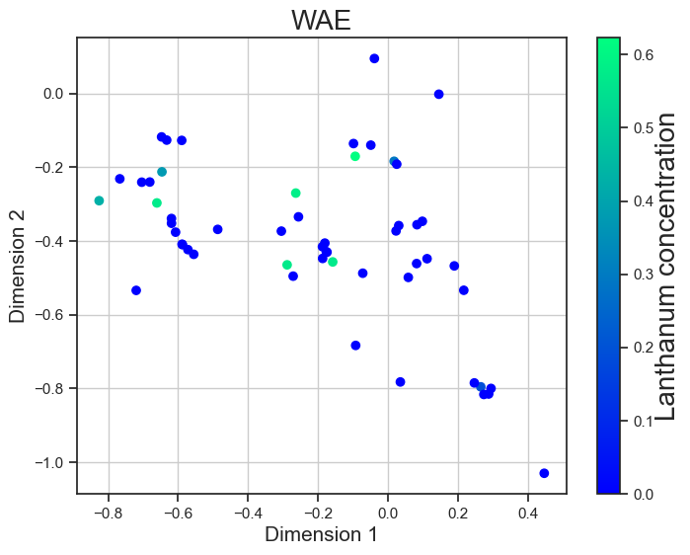
Wasserstein Autoencoders
64 features for
A1,A2,B1,B2
A1/B1,A1B1
A2/B2,A2B2

Slide 18
Conclusions
ML to accelerate DFT
Tested different descriptors (weight and molar composition, elemental…)
Generate a latent space to visualize the dataset
We need to generate more data for successful ML applications (without overfiting)
(combine experimental and calculated data)
Results published in:
Maicon P. Lourenço, Lizandra Barrios Herrera, Jiří Hostaš Patrizia Calaminici, Andreas M Köster, Alain Tchagang, Dennis R Salahub, Phys. Chem. Chem. Phys. 2022, 24, 25227
Jiří Hostaš et. al Compositional and elemental descriptors for perovskite materials. In Workshop on ''Machine Learning for Materials'' ICLR 2023, 2023

Slide 19
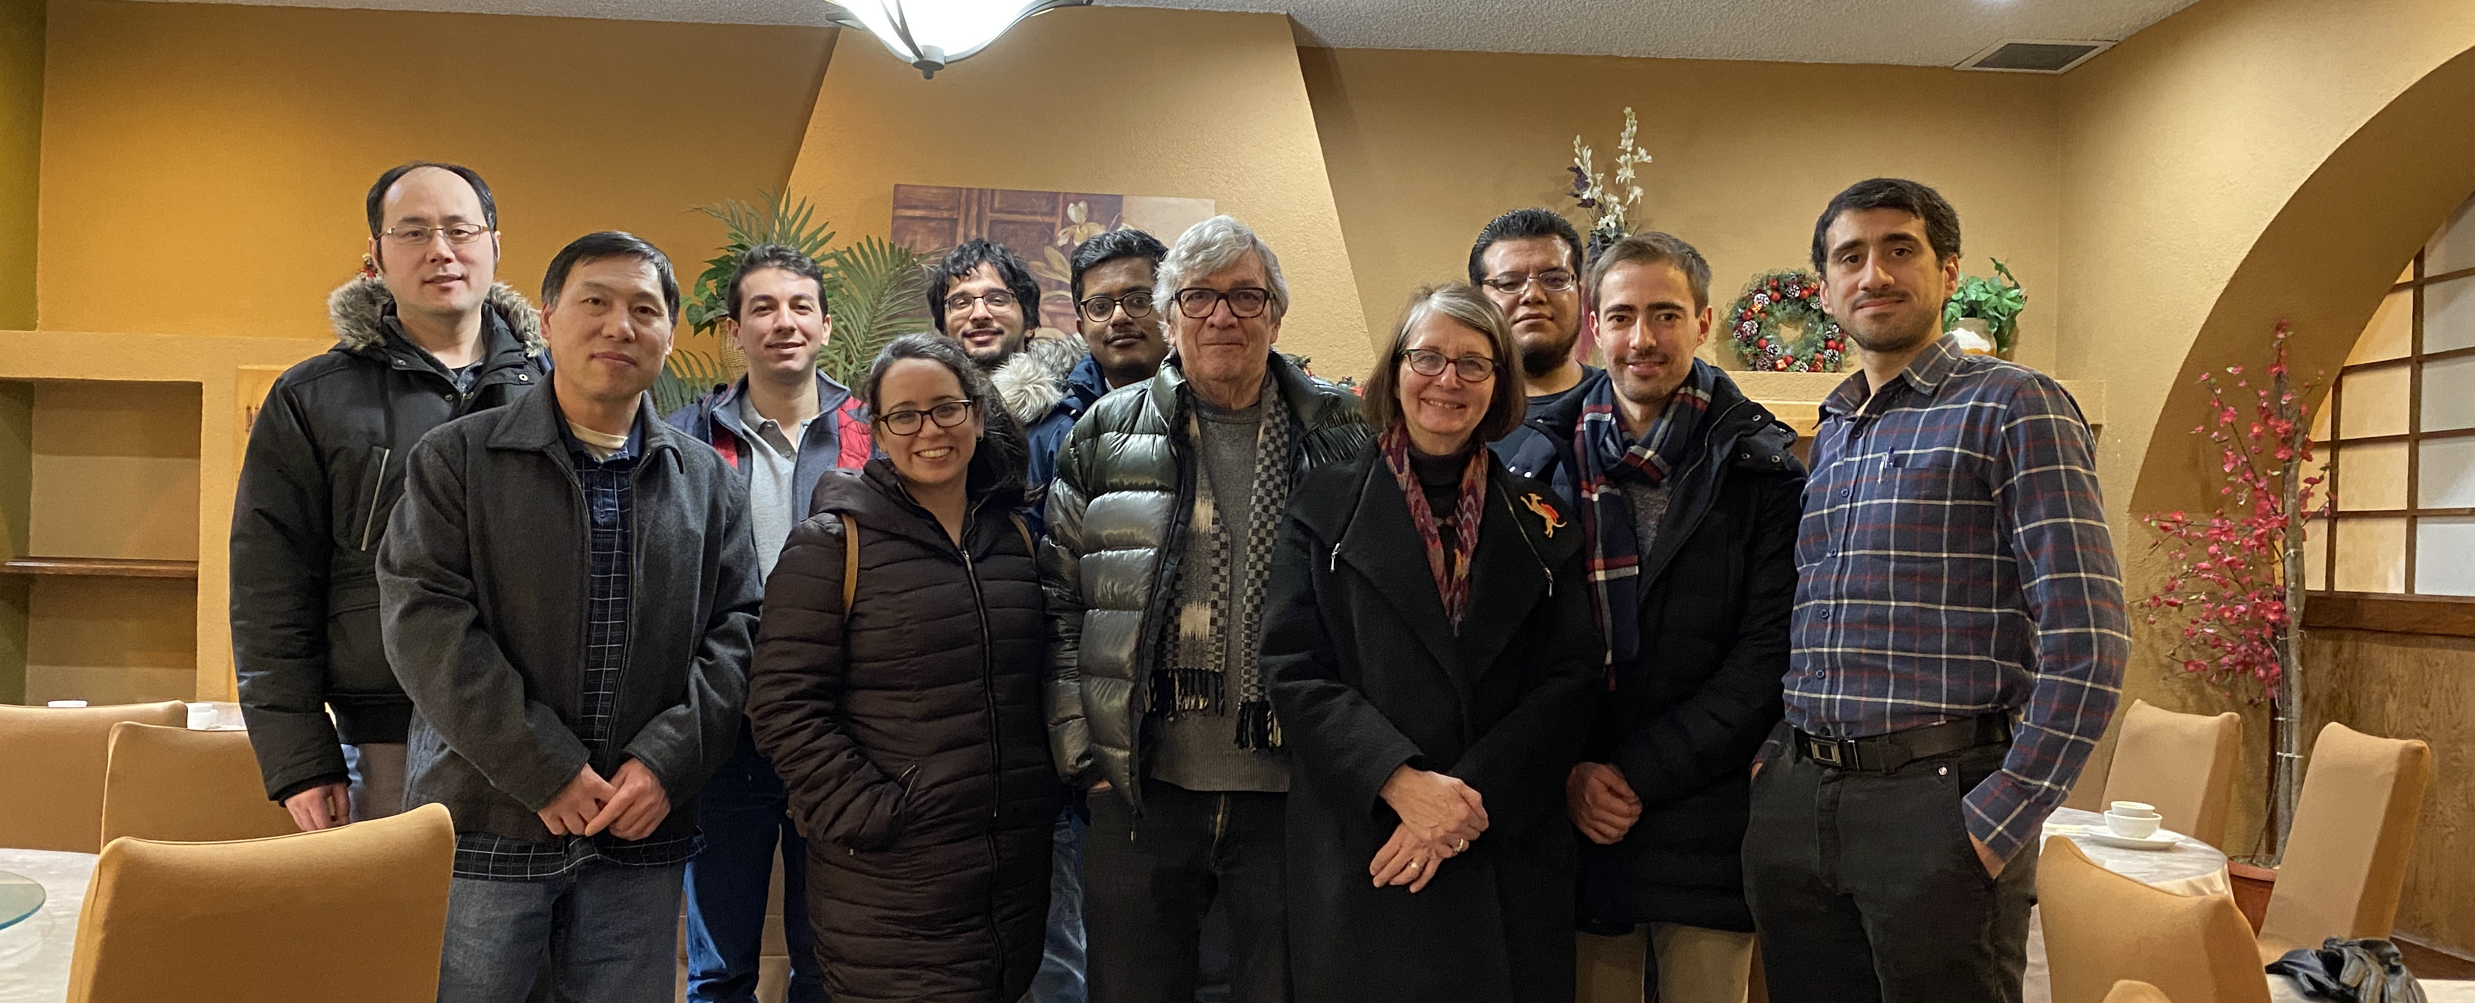


Acknowledgement
Dr. Dennis Salahub
Dr. Maicon Lourenço
Dr. Venkataraman Thangadurai
Dr. Karthik Shankar
Dr. Alain Tchagang
John Garcia
And all my colleagues and collaborators

Slide 20
Thank you for your attention,
questions and comments!

